Slide 1
Module 5.1: Basic Neural Network
Dennis J. Zhang
Washington University in St. Louis

Slide 2
Basic Neural Networks
Machine Learning Basics Revisited
Logistic Regression
Loss Function
Basic Neural Networks
Neuron
Neural Networks
Mathematics of Neural Networks.
Forward propagation
Back propagation

Slide 3


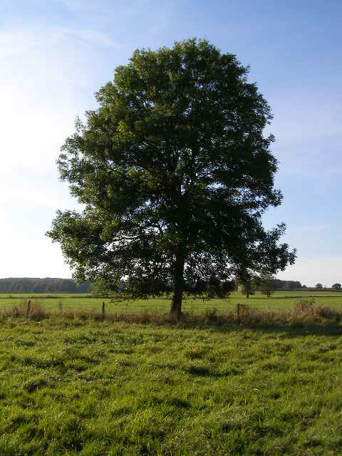
Supervised learning basics
1. Given training data:
Face
Face
Not a face
2. Choose each of these:
Decision function
Loss function
Examples: Linear regression, Logistic regression, Neural Network
Examples: Mean-squared error, Cross Entropy

Slide 4
Supervised learning basics
1. Given training data:
3. Define goal:
2. Choose each of these:
Decision function
Loss function
4. Train with SGD:
(take small steps opposite the gradient)

Slide 5
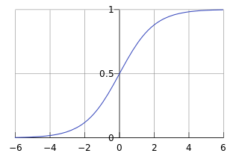
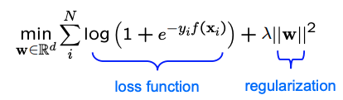
Every Supervised Learning Model
Every machine learning model/system contains the following 5 parts:
Data
Decision Function
Loss Function
Logistic Regression:
Data: (y, X): y is a binary label, X is a vector
Loss Function:
Use a differentiable function instead:

Slide 6
Logistic Regression
Data: Inputs are continuous vectors of length K. Outputs are discrete.
Model: Logistic function applied to dot product of parameters with input vector.
Learning: finds the parameters that minimize some objective function.
Prediction: Output is the most probable class.

Slide 7
Supervised learning basics
Goals for Today’s Lecture
1. Given training data:
3. Define goal:
Explore a new class of decision functions (Neural Networks)
Consider variants of this recipe for training
2. Choose each of these:
Decision function
Loss function
4. Train with SGD:
(take small steps opposite the gradient)

Slide 8
Supervised learning basics
Gradients
1. Given training data:
3. Define goal:
Backpropagation can compute this gradient!
And it’s a special case of a more general algorithm called reverse-mode automatic differentiation that can compute the gradient of any differentiable function efficiently!
2. Choose each of these:
Decision function
Loss function
4. Train with SGD:
(take small steps opposite the gradient)

Slide 9
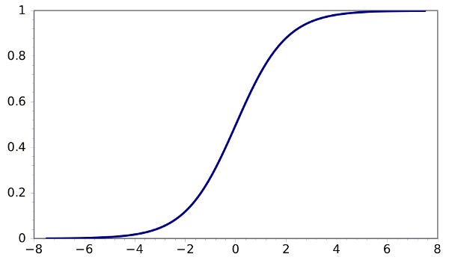
Logistic Regression in Computation Graph
y
Output
θ₁
θ₂
θ₃
θ_{M}
x₁
x₂
x₃
…
x_{M}
Input

Slide 10
Neural Network Model
Inputs
Output
Age
34
.6
.4
.2
Σ
0.6
.1
.5
Gender
2
Σ
.3
.2
.8
.7
Σ
“Probability of beingAlive”
Stage
4
.2
Dependent variable
Prediction
Independent variables
Weights
HiddenLayer
Weights

Slide 11
Combined Logistic Regression Network
Inputs
Output
Age
34
.6
.5
0.6
.1
Gender
2
Σ
.7
.8
“Probability of beingAlive”
Stage
4
Dependent variable
Prediction
Independent variables
Weights
HiddenLayer
Weights

Slide 12
Combined Logistic Regression Network
Inputs
Output
Age
34
.2
.5
0.6
Gender
2
Σ
.3
.8
“Probability of beingAlive”
Stage
4
.2
Dependent variable
Prediction
Independent variables
Weights
HiddenLayer
Weights

Slide 13
Combined Logistic Regression Network
Inputs
Output
Age
34
.6
.2
.5
0.6
.1
Gender
2
Σ
.3
.7
.8
“Probability of beingAlive”
Stage
4
.2
Dependent variable
Prediction
Independent variables
Weights
HiddenLayer
Weights

Slide 14
Combined Logistic Regression Network
Age
34
.6
.4
.2
Σ
0.6
.1
.5
Gender
2
Σ
.3
.2
.8
.7
Σ
“Probability of beingAlive”
Stage
4
.2
Dependent variable
Prediction
Independent variables
Weights
HiddenLayer
Weights

Slide 15
Logistic Regression as a NN
Independent variable = input variable
Dependent variable = output variable
Coefficients = “weights”
Estimates = “targets”
Logistic Regression Model (the sigmoid unit)
Inputs
Output
Age
34
5
0.6
Gender
1
4
Σ
“Probability of beingAlive”
Stage
4
8
Independent variables
x1, x2, x3
Coefficients a, b, c
Dependent variable
p Prediction

Slide 16
Neural Network Decision Function
Output
y
Hidden Layer
z₁
z₂
…
z_{D}
Input
x₁
x₂
x₃
…
x_{M}

Slide 17
Building a Neural Network
y
Output
x₁
x₂
…
x_{M}
Features
Notes:
This is regular perceptron

Slide 18
Building a Neural Network
y
Output
a₁
a₂
…
a_{D}
Hidden Layer
D = M
1
1
1
x₁
x₂
…
x_{M}
Input
Notes:
What if we connect all the X to all the Z?

Slide 19
Building a Neural Network
y
Output
a₁
a₂
…
a_{D}
Hidden Layer
D = M
x₁
x₂
…
x_{M}
Input
Notes:
What if we connect all the X to all the Z?

Slide 20
Building a Neural Network
y
Output
a₁
a₂
…
a_{D}
Hidden Layer
D = M
x₁
x₂
…
x_{M}
Input
Notes:
What if we connect all the X to all the Z?

Slide 21
Decision Boundary
0 hidden layers: linear classifier
Hyperplanes
Example from to Eric Postma via Jason Eisner

Slide 22
Decision Boundary
1 hidden layer
Boundary of convex region (open or closed)
Example from to Eric Postma via Jason Eisner
Notes:
We saw with XOR

Slide 23
Decision Boundary
2 hidden layers
Combinations of convex regions
Example from to Eric Postma via Jason Eisner

Slide 24
Neural Network Architecture
Even for a basic Neural Network, there are many design decisions to make:
# of hidden layers (depth)
# of units per hidden layer (width)
Type of activation function (nonlinearity)
Form of objective function

Slide 25
Activation Function
Neural Network with sigmoid activation functions
Output
y
Hidden Layer
z₁
z₂
…
z_{D}
Input
x₁
x₂
x₃
…
x_{M}

Slide 26
Activation Function
Neural Network with arbitrary nonlinear activation functions
Output
y
Hidden Layer
z₁
z₂
…
z_{D}
Input
x₁
x₂
x₃
…
x_{M}

Slide 27
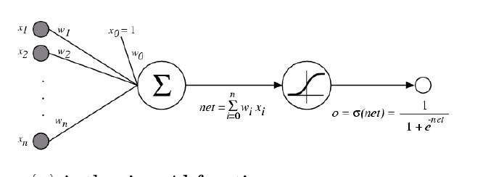
Activation Function
Sigmoid / Logistic Function
So far, we’ve assumed that the activation function (nonlinearity) is always the sigmoid function…

Slide 28
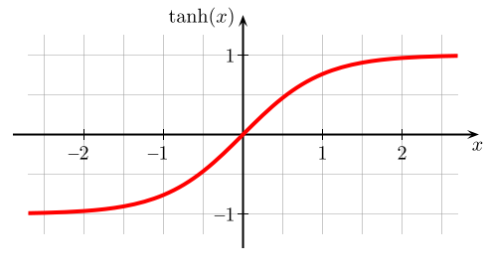
Activation Function Tanh
A new change: modifying the nonlinearity
The logistic is not widely used in modern ANNs
Alternate 1: tanh
Like logistic function but shifted to range [-1, +1]
Slide from William Cohen

Slide 29
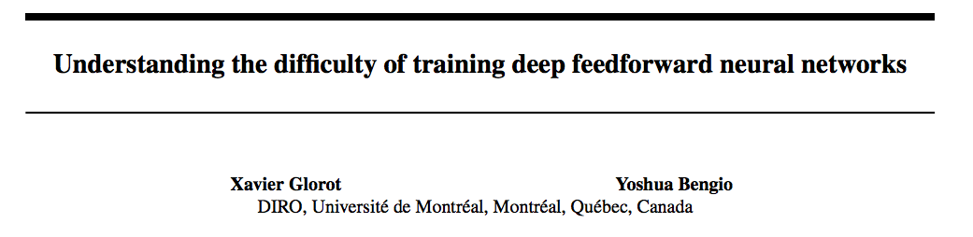
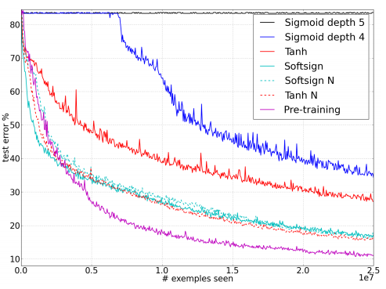
Sigmoid vs Tanh
AI Stats 2010
sigmoid vs. tanh
Figure from Glorot & Bentio (2010)

Slide 30
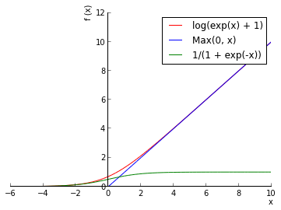
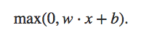
Activation Function reLU
A new change: modifying the nonlinearity
reLU often used in vision tasks
Alternate 2: rectified linear unit
Linear with a cutoff at zero
(Implementation: clip the gradient when you pass zero)
Slide from William Cohen

Slide 31
Objective Function
Regression:
Use the same objective as Linear Regression
Quadratic loss (i.e. mean squared error)
Classification:
Use the same objective as Logistic Regression
Cross-entropy (i.e. negative log likelihood)
This requires probabilities, so we add an additional “softmax” layer at the end of our network

Slide 32
Multi-class Output and Softmax
y₁
…
y_{K}
Output
a₁
a₂
…
a_{D}
Hidden Layer
x₁
x₂
x₃
…
x_{M}
Input
Notes:
Why called feed forward?

Slide 33
Multi-class Output and Softmax
Softmax:
y₁
…
y_{K}
Output
Hidden Layer
a₁
a₂
…
a_{D}
Input
x₁
x₂
x₃
…
x_{M}
Notes:
Why called feed forward?

Slide 34
Training: Back-propagation
Question 1: When can we compute the gradients of the parameters of an arbitrary neural network?
Question 2: When can we make the gradient computation efficient?

Slide 35
Chain Rule
Given:
Chain Rule:
y₁
u₁
u₂
…
u_{J}
x₂

Slide 36
Chain Rule
Given:
Chain Rule:
y₁
Backpropagation is just repeated application of the chain rule from Calculus 101.
u₁
u₂
…
u_{J}
x₂

Slide 37
Chain Rule as Back-propagation
y₁
Given:
Chain Rule:
u₁
u₂
…
u_{J}
x₂
Backpropagation:
Instantiate the computation as a directed acyclic graph, where each intermediate quantity is a node
At each node, store (a) the quantity computed in the forward pass and (b) the partial derivative of the goal with respect to that node’s intermediate quantity.
Initialize all partial derivatives to 0.
Visit each node in reverse topological order. At each node, add its contribution to the partial derivatives of its parents
This algorithm is also called automatic differentiation in the reverse-mode

Slide 38
Back-propagation for Logistic Regression
Output
y
Case 1:
Logistic Regression
θ₁
θ₂
θ₃
θ_{M}
Input
x₁
x₂
x₃
…
x_{M}

Slide 39
Back-propagation for NN
Output
y
Hidden Layer
z₁
z₂
…
z_{D}
Input
x₁
x₂
x₃
…
x_{M}

Slide 40
Back-propagation for NN
Case 2:
Neural Network
y
z₁
z₂
…
z_{D}
x₁
x₂
x₃
…
x_{M}

Slide 41
Back-propagation for NN
y₁
Given:
Chain Rule:
u₁
u₂
…
u_{J}
x₂
Backpropagation:
Instantiate the computation as a directed acyclic graph, where each intermediate quantity is a node
At each node, store (a) the quantity computed in the forward pass and (b) the partial derivative of the goal with respect to that node’s intermediate quantity.
Initialize all partial derivatives to 0.
Visit each node in reverse topological order. At each node, add its contribution to the partial derivatives of its parents
This algorithm is also called automatic differentiation in the reverse-mode

Slide 42
Back-propagation for NN
Case 2:
Neural Network
Module 5
Module 4
y
z₁
z₂
…
z_{D}
Module 3
x₁
x₂
x₃
…
x_{M}
Module 2
Module 1

Slide 43
A Recipe for Machine Learning
Background
Gradients
1. Given training data:
3. Define goal:
Backpropagation can compute this gradient!
And it’s a special case of a more general algorithm called reverse-mode automatic differentiation that can compute the gradient of any differentiable function efficiently!
2. Choose each of these:
Decision function
Loss function
4. Train with SGD:
(take small steps opposite the gradient)

